Slide 1
IoT시스템
10주차 과제
반 YA 학번: 20202296
이름: 전채린

Slide 2
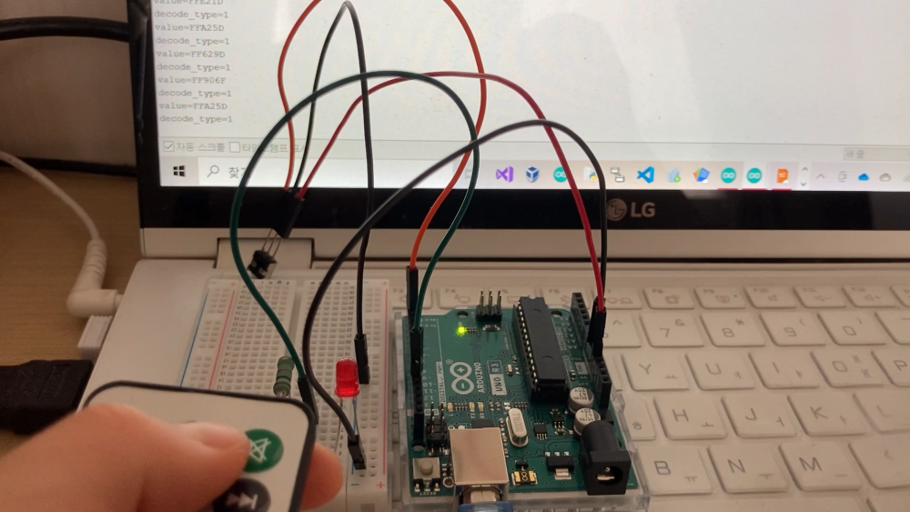
실습1 동영상

Slide 3
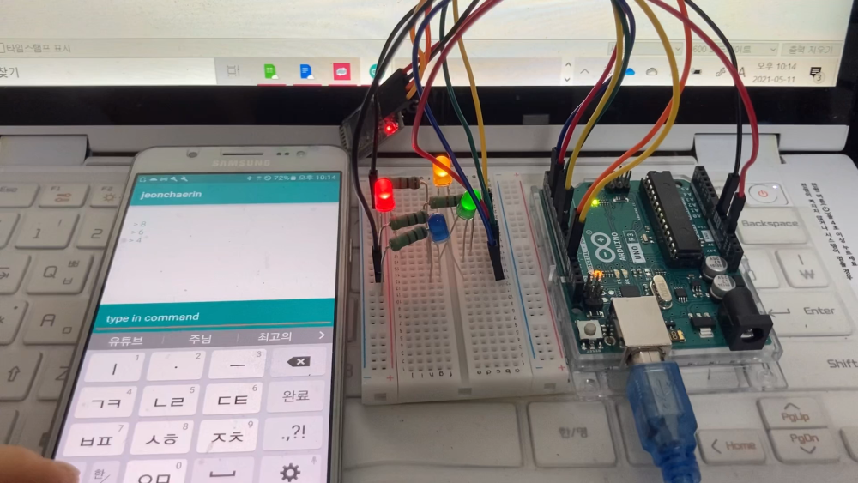
실습2 동영상

Slide 4
실습2 스케치
#include <SoftwareSerial.h>
int bluetoothTx = 12;
int bluetoothRx = 13;
int LED1 = 8;
int LED2 = 4;
int LED3 = 6;
int LED4 = 2;
SoftwareSerial bluetooth(bluetoothTx, bluetoothRx);
void setup()
{
Serial.begin(9600);
delay(100);
bluetooth.begin(9600);
pinMode(LED1, OUTPUT);
pinMode(LED2, OUTPUT);
pinMode(LED3, OUTPUT);
pinMode(LED4, OUTPUT);
}

Slide 5
실습2 스케치
void loop() {
char cmd;
if(bluetooth.available() )
{
cmd = (char)bluetooth.read();
Serial.print("Command = ");
Serial.println(cmd);
if( cmd == '8' )
{
Serial.println("LED1 ON");
digitalWrite(LED1, HIGH);
}
if( cmd == '0' )
{
Serial.println("LED OFF");
digitalWrite(LED1, LOW);
digitalWrite(LED2, LOW);
digitalWrite(LED3, LOW);
digitalWrite(LED4, LOW);
}
}
}
if( cmd == '4' )
{
Serial.println("LED2 ON");
digitalWrite(LED2, HIGH);
}
if( cmd == '6' )
{
Serial.println("LED3 ON");
digitalWrite(LED3, HIGH);
}
if( cmd == '2' )
{
Serial.println("LED4 ON");
digitalWrite(LED4, HIGH);
}
if( cmd == '5' )
{
Serial.println("LED ON");
digitalWrite(LED1, HIGH);
digitalWrite(LED2, HIGH);
digitalWrite(LED3, HIGH);
digitalWrite(LED4, HIGH);
}

